Slide 1
PrintNet T Triple Suite
Data Group By & Data Ungroup

Slide 2

Basic concept
Enables you to organize data according to a field(s) selected in the data file.
This essentially changes the structure of the data, which can help to simplify the Layout design.
Notes:
Enables you to organize data according to a field(s) selected in the data file.
This essentially changes the structure of the data, which can help to simplify the Layout design.

Slide 3
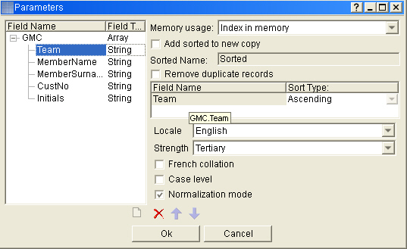
Example
DataGroupBy is often used in combination with DataSorter
In the example we sort the data according to Team variable
Notes:
Enables you to organize data according to a field(s) selected in the data file.
This essentially changes the structure of the data, which can help to simplify the Layout design.

Slide 4
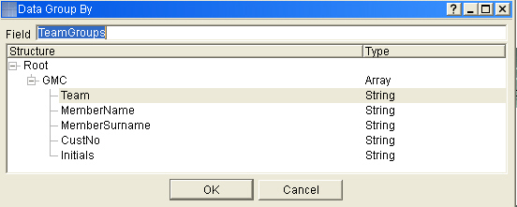
Basic concept
Double-click on Data Group By module to open it
Name the new group
Select the variable according to which the data will be grouped by
In our case each group will contain all the members with the same Team
Notes:
It is necessary to name the group by a descriptive name not just Array
Groups variables with the same described variable

Slide 5
Without/With DataSorter example
Without DataSorter
    Data is not sorted before grouping
    Only data with the same parameter follow directly each other were grouped
    Final number of records is larger than the number of teams
With DataSorter
    Data is sorted before grouping
    Data with the same parameter follow directly each other and were grouped
    Final number of records is the same as the number of teams
Notes:
Data is not sorted before grouping
Only data with the same parameter (SecondName) following directly each other were grouped
Final number of records is larger than the number of families
Data is sorted before grouping
Data with the same parameter
(SecondName) follow directly each other and were grouped properly
Final number of records is the same as the number of families

Slide 6
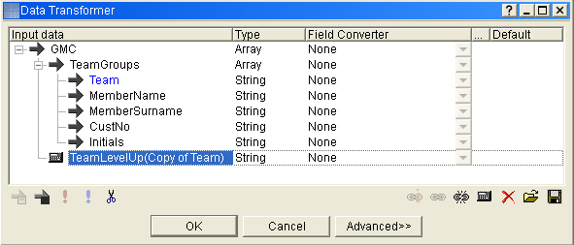
Without/With DataSorter example
Copy level up
Notes:
For better and easier displaying in the layout this functionality in Data Transformer is used

Slide 7
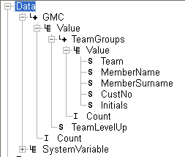
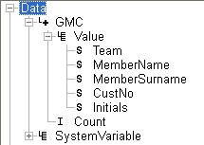
Example screen shots
New array created
It contains var Count – range of the array
Notes:
New array is created within the data structure (Team)
It contains var Count – range of the array. This can be used to display the number of records within the array
New structure
Original structure

Slide 8
Examples of use
Used to group data according to a particular parameter
Simplifies the data structure
Allows to organize design/output according to the groups
    separate each family
    separate different billing options
    separate letters according to a zip code
Notes:
Used to group data according to a particular parameter (Name, ID, ZIP code)
This simplifies the data structure and makes the work with data easier
Allows to organize design/output according to the groups (separate each family, separate different billing options, separate letters according to a zip code,etc.)
is the same as the number of families

Slide 9
Data UnGroup
Removes any individual grouping
Moves fields in a child array up to the parent array
Notes:
Removes any individual grouping made with either by the Data Group By module or the 1-Many Merge module.
Moves fields in a child array up to the parent array and creates a complete record of parent-and-child array for each record in the child array.

Slide 10
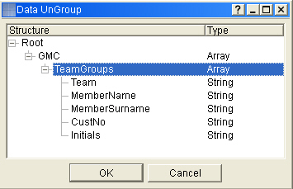
Set-up
Add the module to the workflow and connect it to your data source.
Open the module and select the array you wish to ungroup.
Notes:
Add the module to the workflow and connect it to your data source.
Open the module and select the array you wish to ungroup.

Slide 11
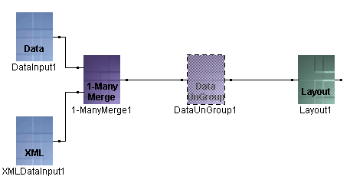
Example of use
Use to simplify data structure after 1-Many Merge
Notes:
Removes any individual grouping made with either by the Data Group By module or the 1-Many Merge module.
Moves fields in a child array up to the parent array and creates a complete record of parent-and-child array for each record in the child array.

Slide 12
Data Ungroup – example of use
Without With
Notes:
Removes any individual grouping made with either by the Data Group By module or the 1-Many Merge module.
Moves fields in a child array up to the parent array and creates a complete record of parent-and-child array for each record in the child array.
Simplifies the data structure

Slide 13

Any questions? Thank You.

